Slide 1
Field Geology
“On first examining a new district, nothing can appear more hopeless than the chaos of rocks; but by recording the stratification and nature of the rocks and fossils at many points, always reasoning and predicting what will be found elsewhere, light soon begins to dawn on the district, and the structure of the whole becomes more or less intelligible.”
- Charles Darwin

Slide 2
What is a Geologic Map?
Geologic maps constitute a fundamental and objective scientific foundation on which land-use, water-use, and resource-use decisions are based. A geologic map records the distribution of rock and sediment materials at and near the land surface, and is the best science product to display the information that decision makers need to identify and protect valuable resources, avoid risks from natural hazards, and make wise use of our land.

Slide 3
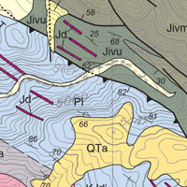
The geologic mapper strives to understand the composition and structure of geologic materials at the Earth's surface and at depth, and to depict observations and interpretations on maps using symbols and colors.

Slide 4
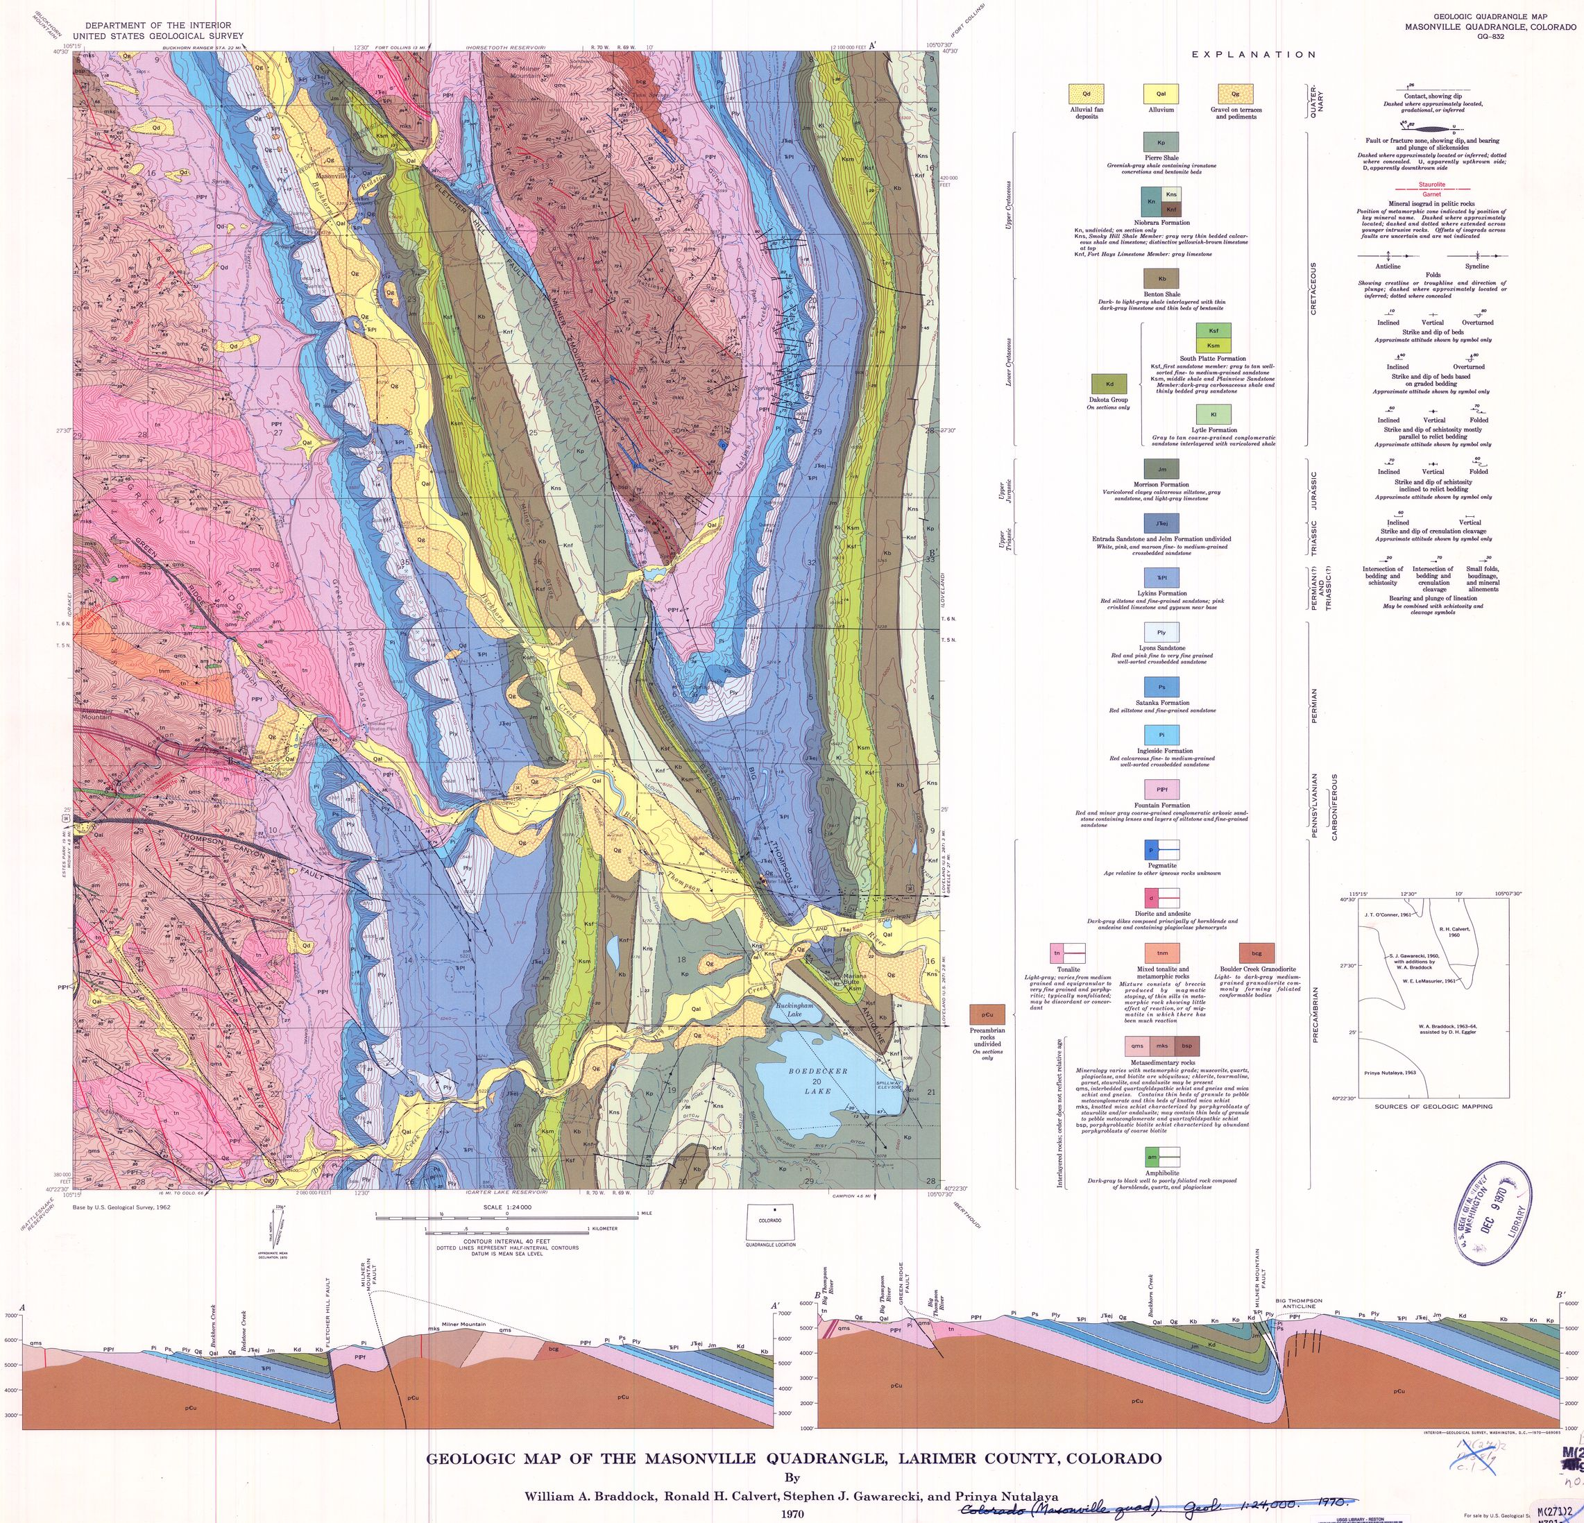

Slide 5
Drawing Map Contacts
Three fundamental types of contacts: Depostional, Fault and Intrusive.
  Solid lines are definite contacts, dashed lines are approximate contacts, dotted lines are concealed contacts.
  Faults are drawn in heavier lines and have associated kinematic symbols.

Slide 6
Drawing Map Contacts Continued
Discordant intrusive rock bodies have irregular contacts.
Tabular rock bodies have planar or curviplanar contacts. Faults behave this way too.
  Most depositional contacts
  Dikes and sills
  When flat lying these contacts follow topography
  When vertical they are straight
  When dipping they follow the rule of Vs.
  These can be predicted and logically projected based on topographic expression, vegetation, etc.
    i.e. they do not rapidly change orientation

Slide 7
Objectives of Mapping
Accurately show surface distribution of bedrock units (i.e. contacts)
Present sufficient structural data to interpret the three-dimensional subsurface geometry of rock units
You can’t have too much structure data!

Slide 8
Mapping Procedures
Keep field and office maps
  Your office map is your insurance policy
Do all mapping in the field
  Draw all contacts in the field
  Color units in the field
  Plot strikes and dips in the field
  Why? –
    Allows you to see inconsistencies and plan a mapping strategy
    Field maps will be collected and graded daily

Slide 9
Mapping Procedures
Keep track of your location at all times
  Know the contour interval and scale of the map
  Use terrain recognition, triangulation or any other method to accurately locate yourself
Keep a record of your field stations
  Identify the location of each station in your notebook and on your map.

Slide 10
Drawing Map Contacts
Use different lines for different types of contacts
  Solid, dashed, and dotted all indicate something different
Tabular rock bodies have planar or curviplanar contacts
  Most depositional contacts
  Dikes and sills
  These can be predicted and logically projected based on topographic expression, vegetation, etc.
    i.e. they do not rapidly change orientation

Slide 11
Drawing Map Contacts
Dipping beds: Obey the Rule of V’s
  Contacts will commonly “V” in the direction of dip
    One exception to this rule:
      when bedding dips less steeply, and in the same direction as the surface slope, V points up-dip
Contacts will parallel strike ridges and hogbacks
  Contacts commonly occur at the base of a dip or an anti-dip slope
Contacts may be zig-zag or diamond shaped along flatirons

Slide 12
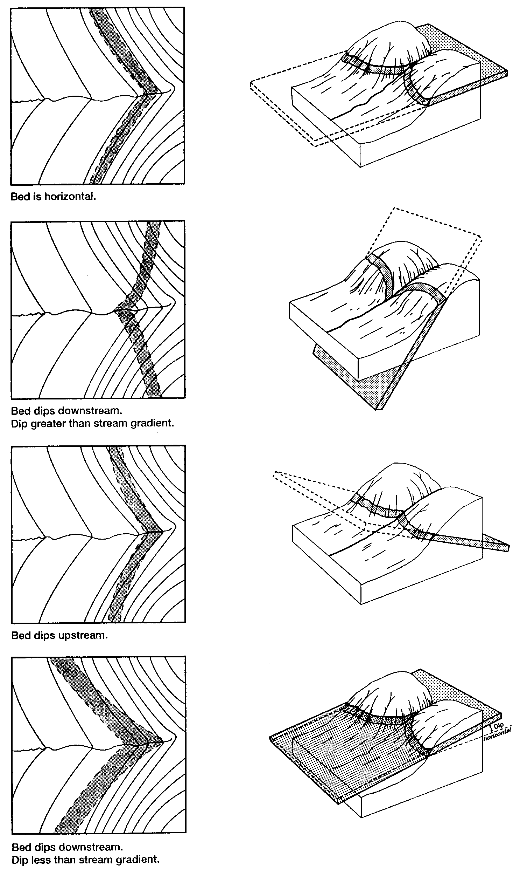
Rule of V’s

Slide 13
Rule of V’s

Slide 14
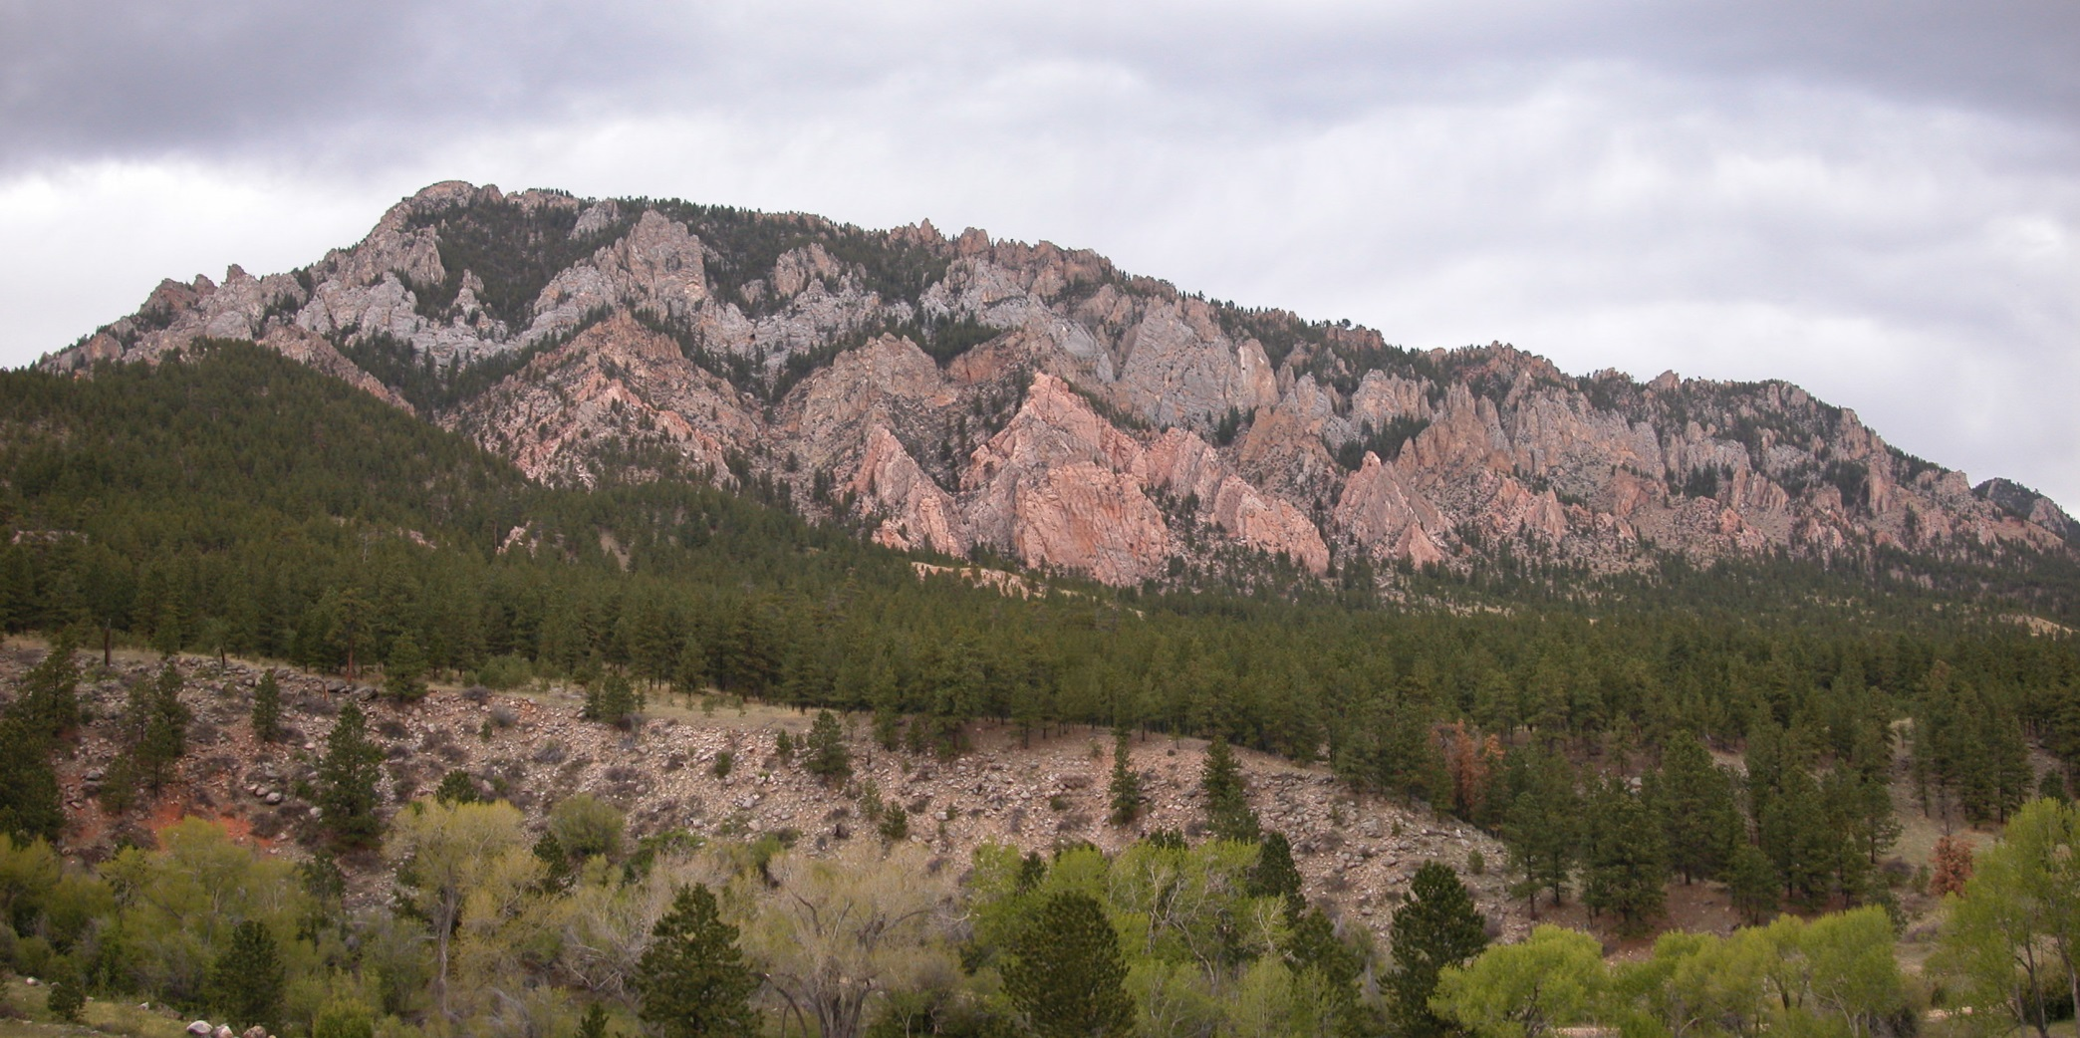
Flatirons

Slide 15
Special Map Units
Qal – Quaternary alluvium
  Refers to Recent stream deposits
  Generally flat-lying…..gently sloping down stream
  Found where streams have low gradients
  Generally thin for mountain streams.
Qls – Quaternary landslide
  Refers to recent landslide deposits
  Often indicated by convex down-hill distortions of elsewhere parallel topographic contours
Bedrock contacts should be dotted as concealed beneath these deposits

Slide 16
Coloring Your Map
Do this in the field
  Color lightly – you’re going to erase a lot
Choose visually appealing colors
  USGS has selected colors for different time periods
  Reserve yellows and oranges for Qal and Qls

Slide 17
Official USGS Map Colors
Quaternary | orange
Tertiary | yellow ocher
Cretaceous | olive-green
Jurassic | blue-green
Triassic | bluish gray-green
Permian | blue
Pennsylvanian | gray
Mississippian | blue-violet
Devonian | heliotrope
Silurian | purple
Ordovician | red-violet
Cambrian | brick red
Precambrian | pink or gray-brown

Slide 18
Structural Data
Be careful to select a good spot to measure
  No slump blocks
  No cross-bedding surfaces
Collect enough data to accurately represent the structural geometry of the area
  Depends on structural complexity of area
  Attempt uniform distribution of data when possible
  Gather more data along your line of cross section.

Slide 19
Good Field Sketches Result in a Better Map
Sketch out complicated map patterns
  Helps you recognize problems
  Develop multiple working hypotheses for how units are arranged
Sketch out simplified cross sections
  Helps you recognize poor surface contact placement
  Helps you identify faults and determine their geometry and sense of slip
  Helps you when you later draw your final cross section

Slide 20
Variables Affecting Map Patterns
Formation thickness
Formation dip
Surface topography
  Map patterns are predictable when units are uniformly thick and homoclinally dipping

Slide 21
Testing for Mapping Accuracy
Don’t forget thickness, depth, and three-point problems will help!
Calculate strike and dip from your map pattern
  It should match the measured value
Construct the outcrop pattern in areas that are poorly constrained
  Requires uniform dips and thicknesses
Calculate formation thickness from your map pattern
  It should be in the range we established, unless noted otherwise.

Slide 22
What you need for tomorrow
A positive attitude
Colored pencils
Map (something to cover it in a rainstorm)
Clipboard
Protractor/Ruler
Compass
Radio – one per group
Rain gear

Slide 23
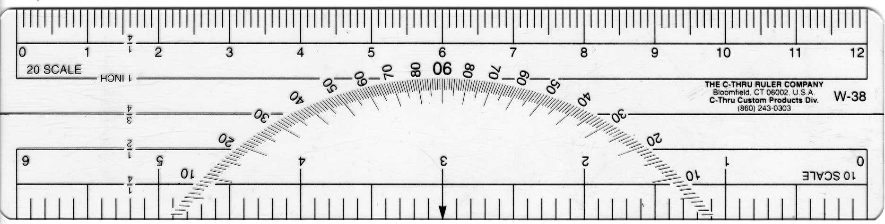
9
8
7
6
5
4
3
2
1
0
0
1
2
3
4
5
6
7
8
9

Slide 24
R.2 E.
R.3 E.
35
36
31
32
T.6 N.
T.5 N.
BM
2
1
6
5

