Slide 1
Constructing a Geological Cross Section
Select a section line
Construct a topographic profile along the line of section
Transfer contacts from the map to the topographic profile
Project dip data into the cross section line
Calculate and plot apparent dips on the topographic profile
Construct the subsurface interpretation
Notes:
From Roland, S.M. and Duebendorfer, E.M., 1994, Structural Analysis and Synthesis, 2nd Edition: Blackwell Scientific Publications, Boston, 279p.

Slide 2
Selecting a Section Line
Identify regional structural trends
Draw section line perpendicular to regional structural trends and through areas that best depict the structure
  May need more than one section line
Draw sections through area(s) with the best structural control
  Most reliable contacts
  Nearby structural data

Slide 3
Constructing a Topographic Profile

Slide 4
Step 1: Mark the intersection of each topographic contour line with the section line

Slide 5
Step 2: Graph the elevation of each point in its appropriate position

Slide 6
Step 3: Connect the Dots
Use logical, whole number increments for the vertical scale.
Notes:
Label both sides of the cross section. Include directions on either side of the graph (east-west or north-south). Also include horizontal and vertical scale in text.
Label endpoints
For the Amsden Creek project, you should draw your cross section down to 1000’ above sea level.
Check Appendix 3 for specifics that should be included.

Slide 7
Transferring Contacts from the Map to the Topographic Profile
Step 1: Mark the intersection of each contact, fault or unconformity with the section line
Notes:
Use the same method you used for topography, mark the contact on your topographic profile.

Slide 8
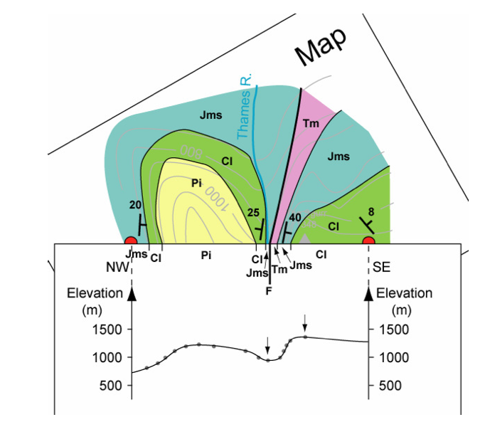
  http://www.geos.ed.ac.uk/homes/mattal/Maps.pdf

Slide 9
Transferring Contacts from the Map to the Topographic Profile
Step 1: Mark the intersection of each contact, fault or unconformity with the section line
Step 2: Transfer the location of each contact, fault or unconformity marked on the section line to the topographic profile
Notes:
Use the same method you used for topography, mark the contact on your topographic profile.

Slide 10
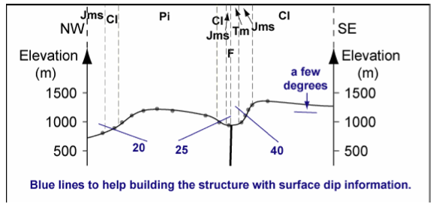

Slide 11
Projecting Dip Data into the Cross Section Line
Step 1: Identify which dip data you will use
  Use data that occurs in a narrow band along either side of your section line
    Projection distance is inversely proportional to structural complexity

Slide 12
Projecting Dip Data into the Cross Section Line
Step 2: Project the data into the cross section line
  Project parallel to strike to the point where the projection line intersects the section line
    Do not project across formation boundaries, faults or unconformities
  Intuitively use data close to the section, even if it doesn’t project into the section line
    e.g. contacts striking parallel to the section line will appear horizontal in the section plane

Slide 13
Projecting Dip Data into the Cross Section Line
Step 3: Transfer the location of each projected dip data point to the topographic profile (tadpole)

Slide 14
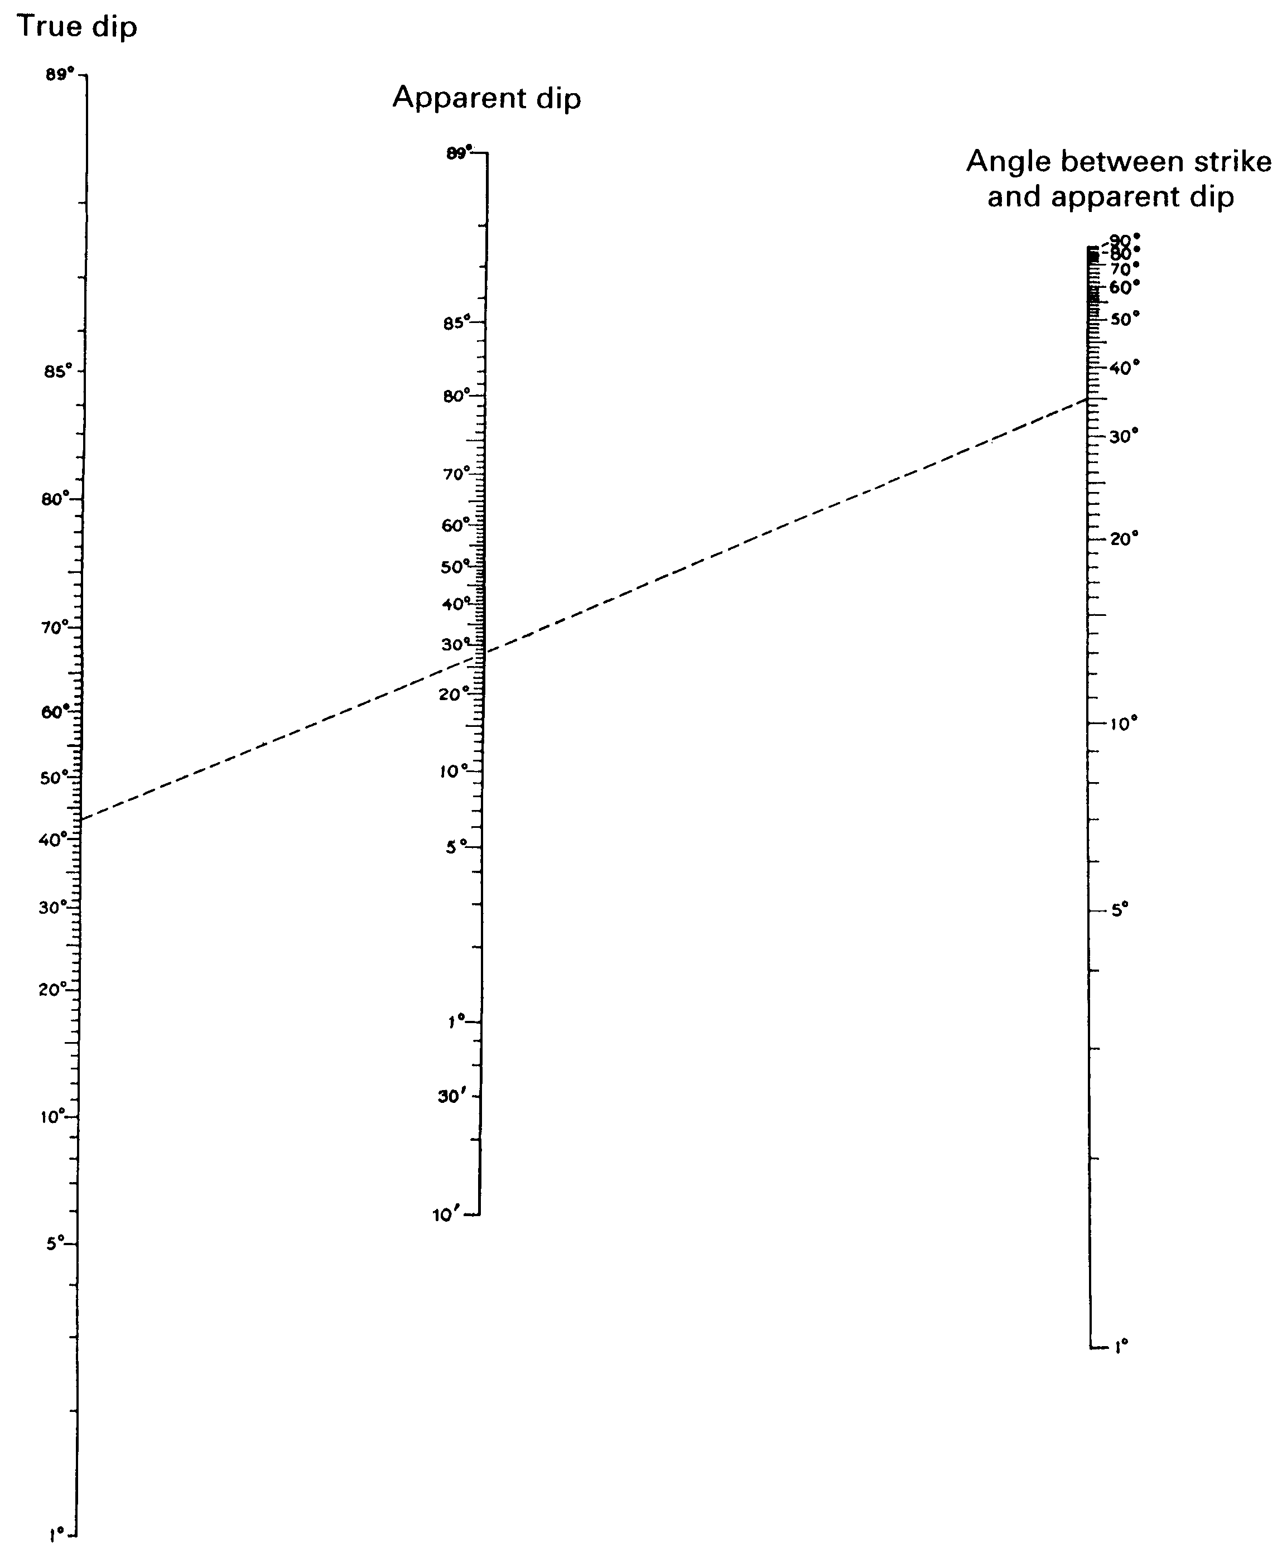
Calculate Apparent Dips
Use apparent dip nomogram to determine the apparent dip of each data point projected into the cross-section plane
  Page 83
Notes:
This figure is on page 97 of the guidebook
Angle between the strike and the apparent dip is the angle between the strike and the cross section line (topographic profile)

Slide 15
Plot Apparent Dips on the Topographic Profile
Step 1: At each apparent dip data point, use a protractor to measure down from horizontal, the angle equal to the calculated apparent dip
Step 2: Draw in the apparent dip symbol at the appropriate angle, and in the appropriate direction
  These angles must be drawn precisely, not just eyeballed

Slide 16
Construct the Subsurface Interpretation
Remember: A cross section is an interpretation!
  Honor your data
  Uniform layer thickness unless you have good evidence to the contrary
    Remember squishy units are more likely to change thickness
  Dip angles may only be valid for a short distance
    They don’t continue forever with increasing depth

Slide 17
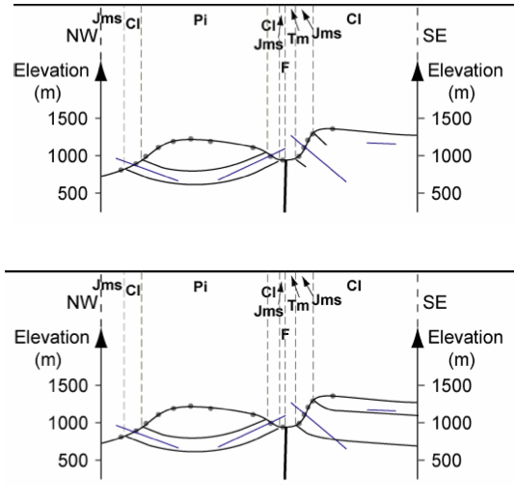
  http://www.geos.ed.ac.uk/homes/mattal/Maps.pdf

Slide 18
Principles of Cross Section Construction
Viability Criteria
  Assume areas and lengths of rock layers remain constant during deformation
    True under plane strain conditions where temperatures are < 250˚ C
  Each unit lies at a unique regional elevation when not uplifted by faulting or intrusions
  Faults must have realistic geometries and kinematics
    No gaps or overlaps between fault blocks
    No changes in slip sense
    Realistic displacement gradients

Slide 19
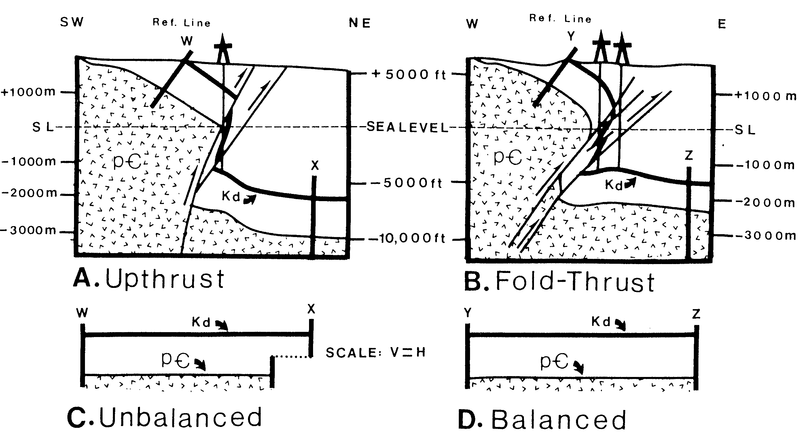
Interpretation Changes are Forced by Line Length Balance

Slide 20
Principles of Cross Section Construction
Admissibility Criteria
  Interpret in a manner that is consistent with established regional structural styles
    But, you can still discover something new!
  Do not add complexity where it is not supported by the data
    Occam’s Razor
      (14th Century Franciscan Friar and logician, William of Ockham)
    Usually, the simplest answer is the best answer

Slide 21
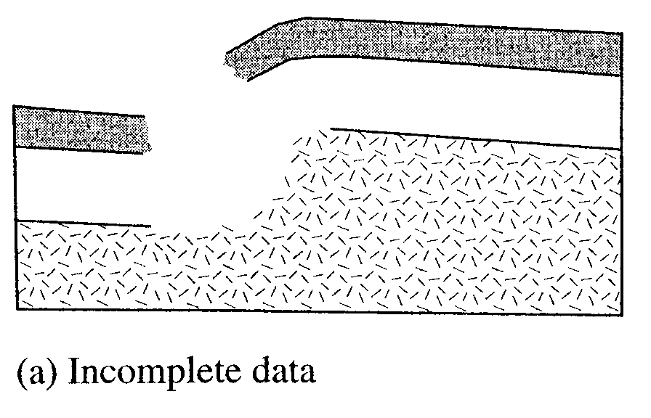
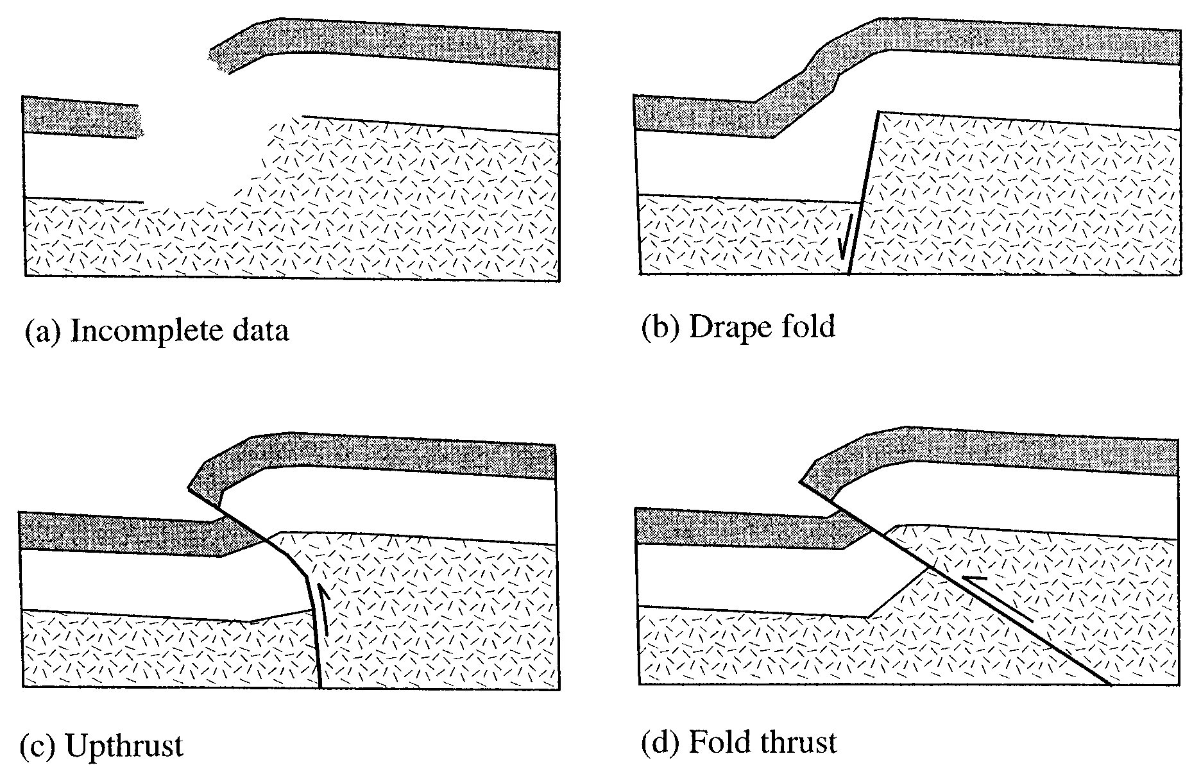
Evolution of Structural Interpretations
1960’s
1970’s
1980’s

Slide 22
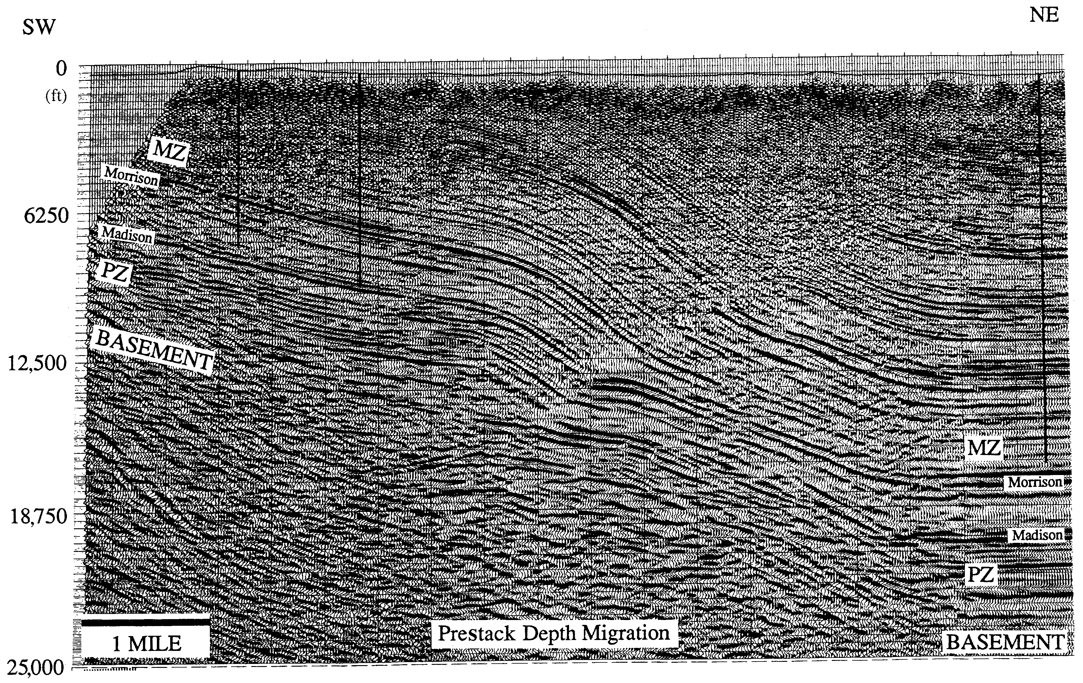
East Grass Creek Seismic Profile
Mitra and Mount (1998)

Slide 23
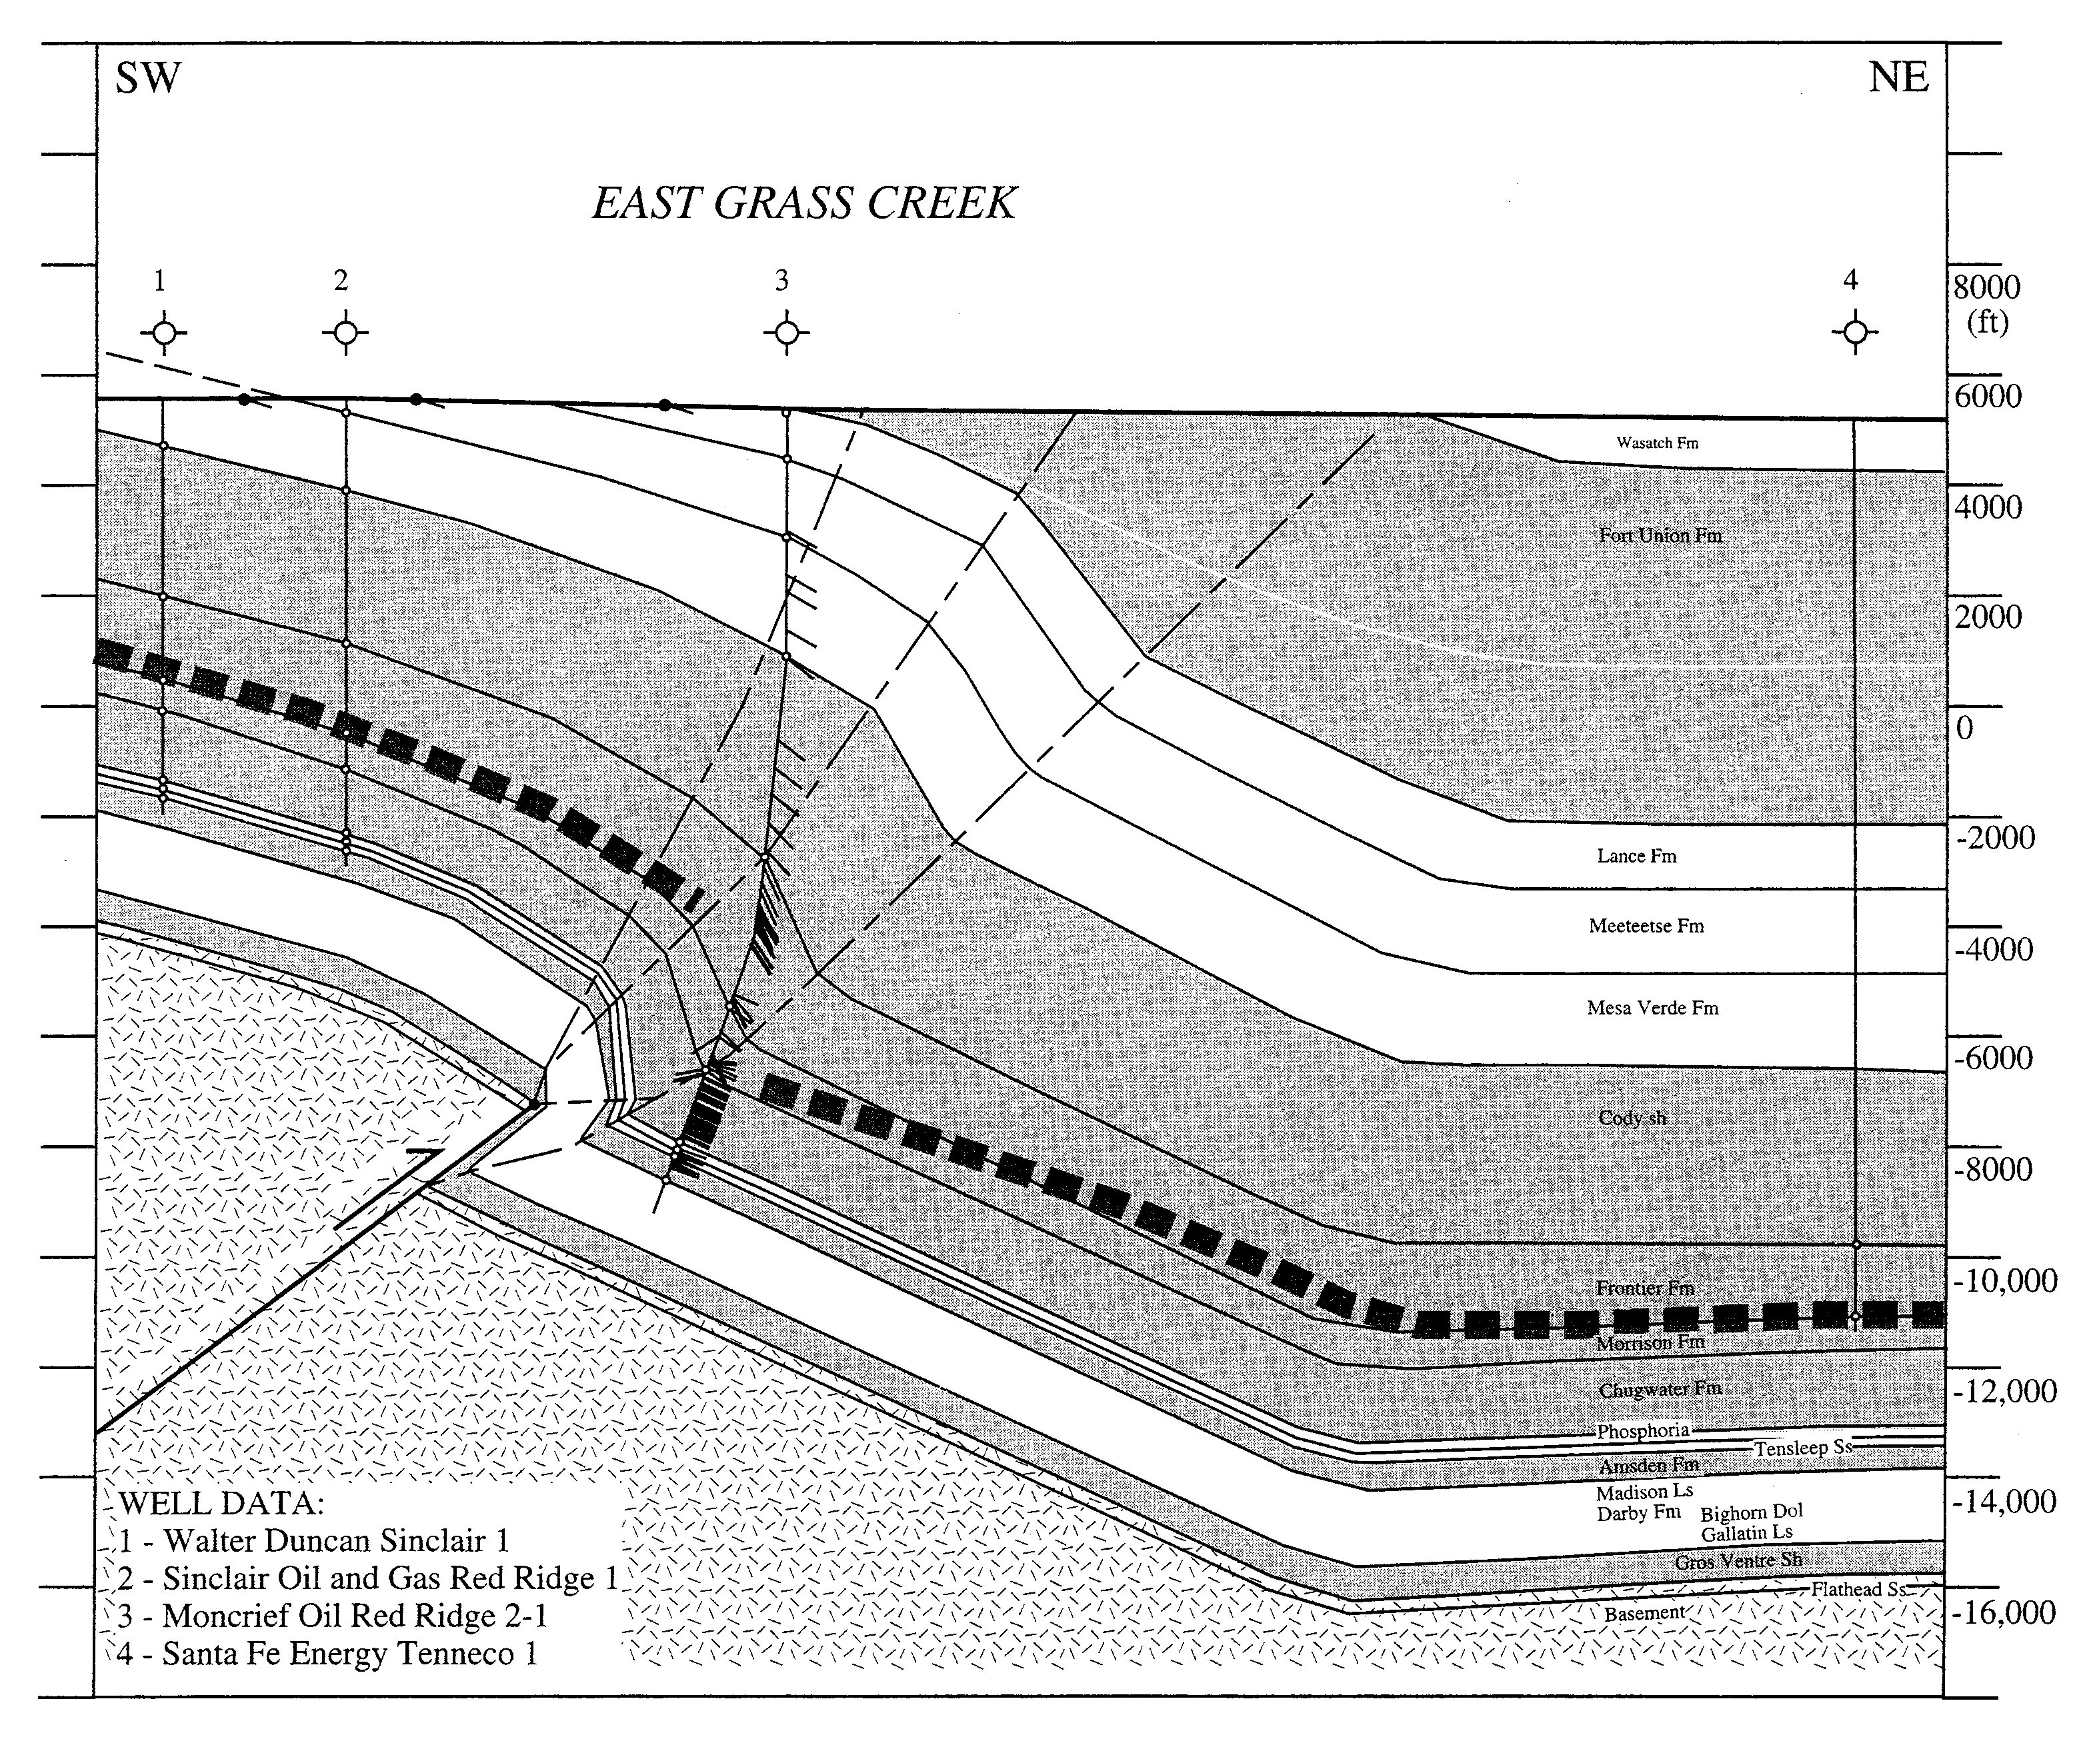
East Grass Creek Cross Section
Mitra and
Mount (1998)

Slide 24
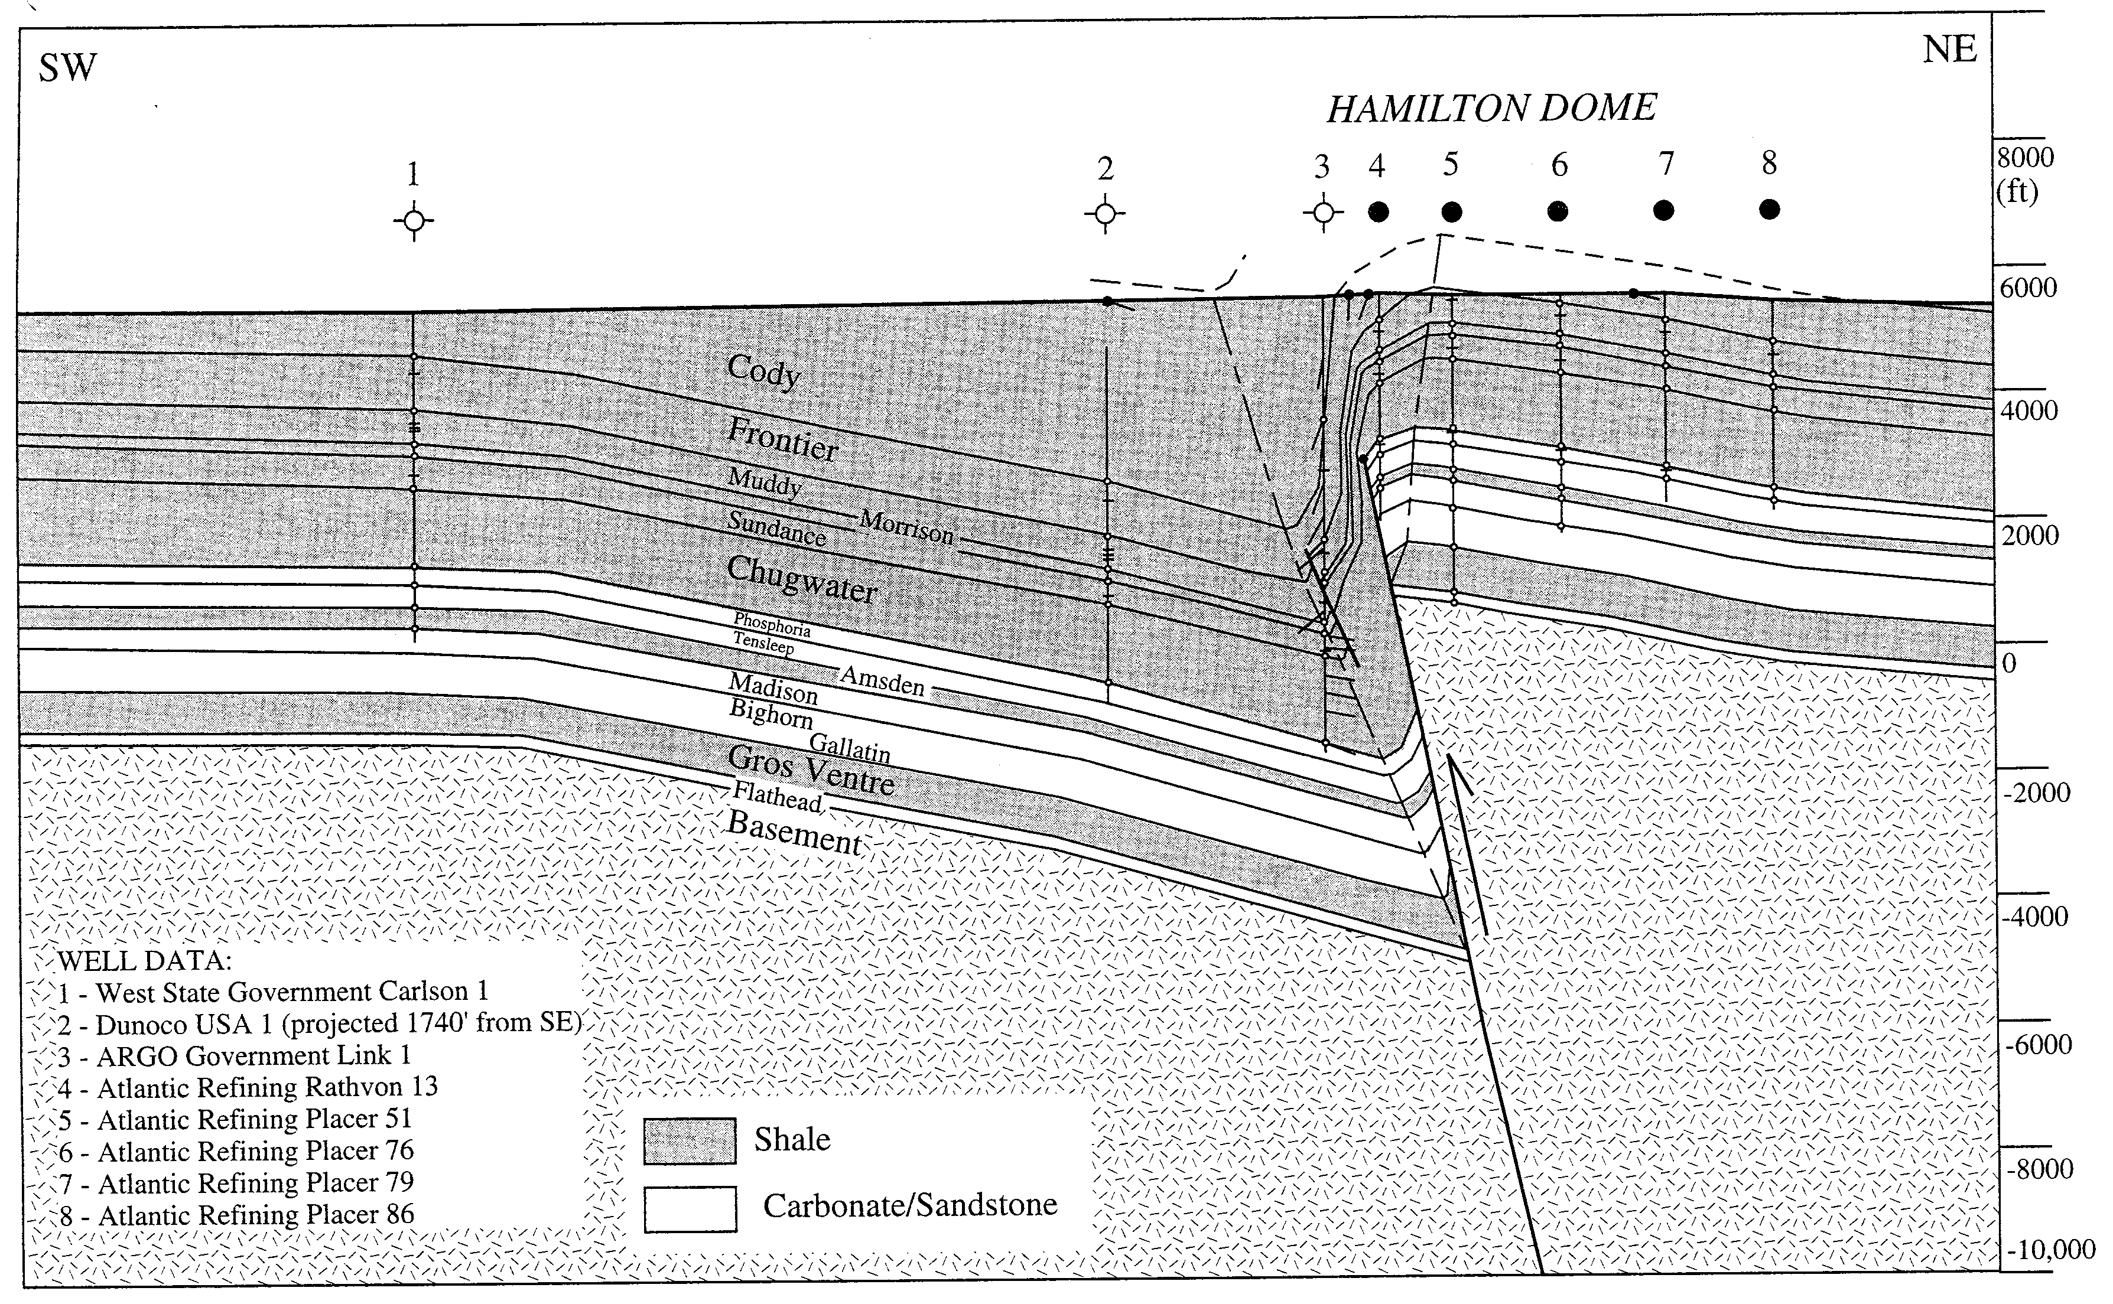
Hamilton Dome Cross Section
Mitra and Mount (1998)

Slide 25
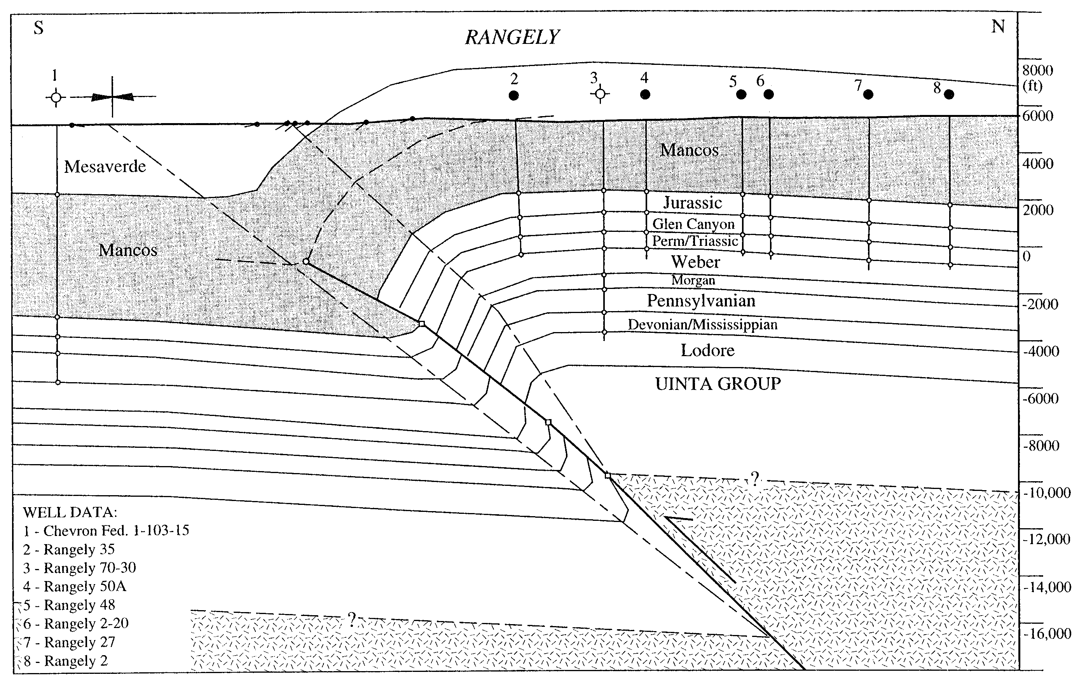
Rangely Anticline Cross Section
Mitra and Mount (1998)

Slide 26
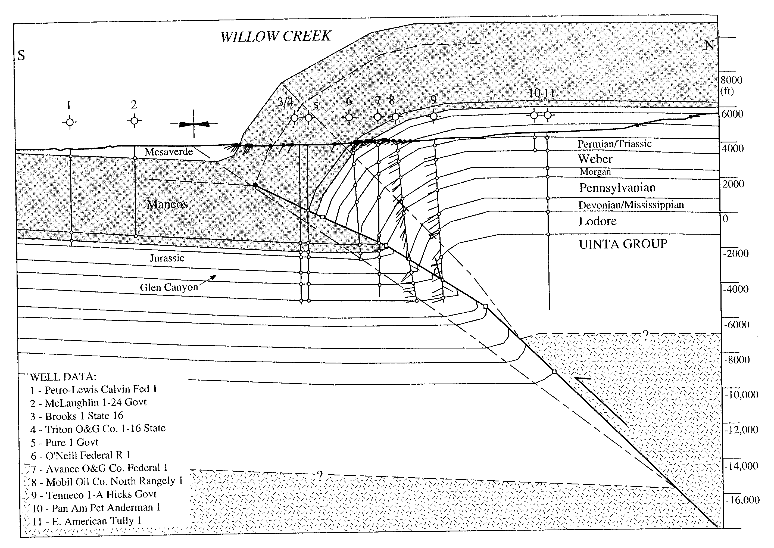
Willow Creek Cross Section
Mitra and Mount (1998)

Slide 27
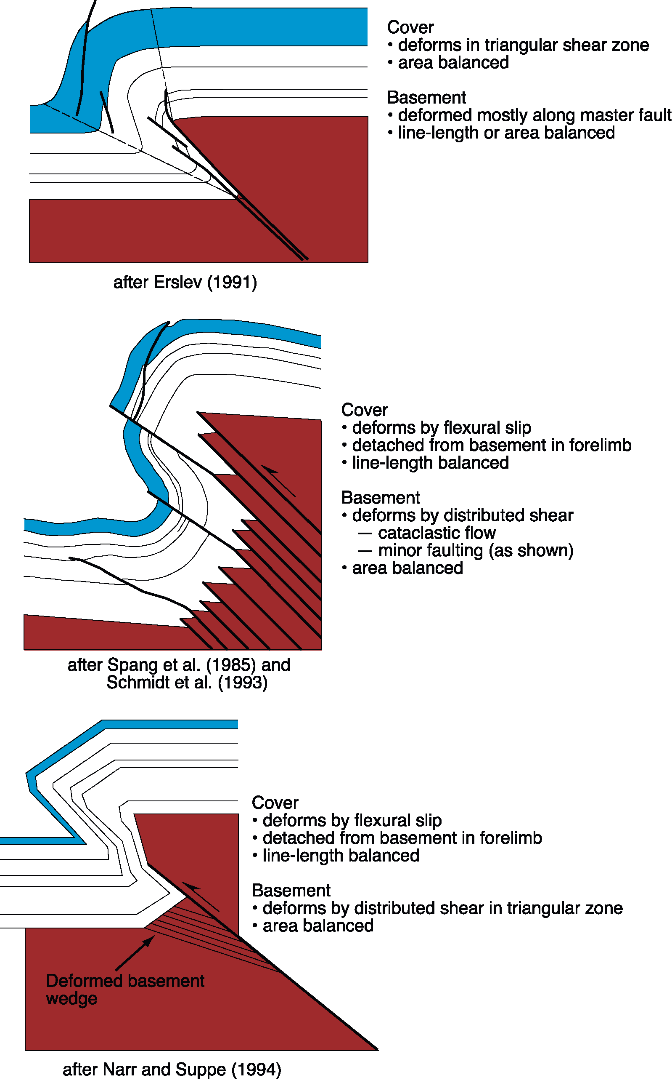
Modern Models of Basement-Involved Fault-Related Folds

Slide 28
Common Cross Section Errors
Contacts on map don’t match those on the section line
Ignoring dip data
Topography-induced folding
Blank spaces underground
Incorrect stratigraphic sequence
Mismatch between intersecting section lines
  Appendix 3 page 89 for more Essentials

Slide 30
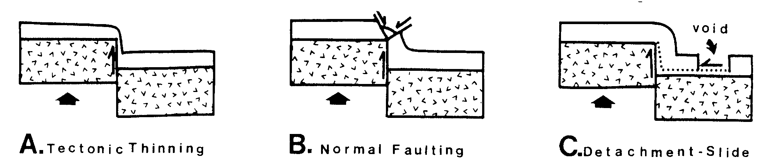
Good Cross Sections will “Balance”

Slide 31
Links to check out:
  http://www.geos.ed.ac.uk/homes/mattal/Maps.pdf
  http://www.uwgb.edu/dutchs/structge/SL49SimpXSec.HTM
  http://resources.arcgis.com/gallery/file/geoprocessing/details?entryID=C83CC388-1422-2418-7F10-B4D3DF5F1EE6
  http://serc.carleton.edu/woburn/student-modules/geo_setting/crosssection.html

